Slide 1

ELL Instructional Academy WS# 99766
Karina E. Chapa, M.Ed.
Language Proficiency, Biliteracy and Cultural Diversity Director
kchapa@esc1.net
@bilingualpride @esc1bilingual

Slide 2

Professional Learning Essential Agreements
Be respectful
Be an active participant
Take care of your needs
Use electronic devices as learning tools

Slide 3




Karina Elizabeth Zuno Cooley
“Karina Chapa”

Slide 4
Parking Lot Questions
What are you expecting to learn at this Academy?
Why are you interested in learning this?
What will you do with what you learn?

Slide 5
ELL leadership academy
Rationale

Slide 6
English Learners in Texas
160,000+
in Region One
Source: TEA, 2018

Slide 7
Changing Texas: 2050
Average Age
NHW 42
HW 28
Population
NHW 2%
HW 70%
Workforce
H vs NH
3:1
ECONOMIC
PRECIPICE
“In the absence of change, the Texas labor force as a whole will be less-educated, work in lower-status occupations, and have lower incomes in 2050 than 2010”
Steve Murdock, 2013

Slide 8
Changing Texas: 2050
Average Age
NHW 42
HW 28
Population
NHW 2%
HW 70%
Workforce
H vs NH
3:1
EDUCATION
FUTURE PROSPERITY
We are that CHANGE!

Slide 9
The Power of Region One
97% Hispanic
37% ELL PK-12
85% EcoDis
Region One TODAY
Texas in 30 Years

Slide 10
Second Language Acquisition
TELPAS-ELPS Connection
ELL Subpopulations (SpEd, GT)
Designated Supports
Sheltered Instruction

Slide 11
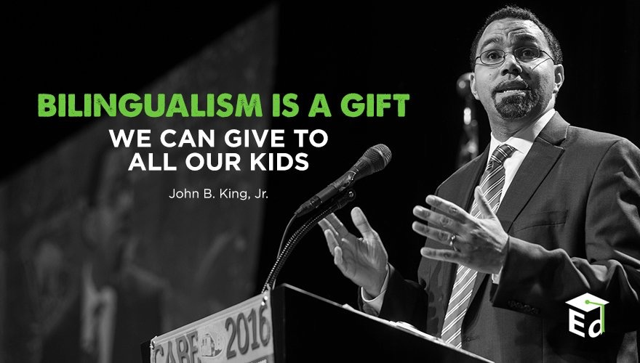
Second Language Acquisition
Notes:
45 mins

Slide 12
Session Objectives
Content Objective
Language Objective
Today I will analyze the second language acquisition process and understand its impact in the education of English Language Learners.
Today I will discuss with my peers the second language acquisition process and I will share orally and in writing my individual language profile.

Slide 13

SLA Anticipation Guide
Let’s
kahoot.it

Slide 14
Language Power
Cognitive
Social
Affective
“Language stands at the center of the many interdependent cognitive, affective, and social factors that shape learning”.
David Corson, 1999
LANGUAGE
=
IDENTITY
3-Step Interview

Slide 15
The Iceberg Theory
Basic Interpersonal Communication Skills
BICS
1-3 years
CALP
5-7 years
Cognitive Academic Language Proficiency
J. Cummins, 1981

Slide 16
Double Iceberg Theory
BICS L1 1-3 years
BICS L2 1-3 years
CALP L1+L2
5-7 years
J. Cummins, 1981

Slide 17
Transfer of Concepts
L1
L2
CALP
L1
L2
J. Cummins, 1981

Slide 18
In Other Words…
BICS L1
BICS L2
CALP
L1
L2
CALP Transfer L1-L2
J. Cummins, 1981

Slide 19
Research Findings
The stronger academically and cognitively the L1, the stronger the L2.
The weaker academically and cognitively the L1, the weaker the L2.
W. Thomas & V. Collier, 2009
Turn and Talk
Think-Pair-Share

Slide 20
My Language Profile
BICS Spanish
BICS English
CALP Spanish + English
1999

Slide 21
My Language Profile
BICS Spanish
BICS English
CALP Spanish + English
2018

Slide 22
Your Turn!
BICS L1
BICS L2
CALP L1+L2
Create your own language profile
Birthday Line
Notes:
90 mins

Slide 23
Bilingual Program Models
Chapter 89, Jigsaw/Frayer Model
Bilingual Education
Subtractive ( - )
Submersion
Early Exit
Additive (+)
Late Exit
Dual Language
One-Way
Two-Way

Slide 24
Frayer Model
Early Exit
Late Exit
One-Way DL
Two-Way DL
Bilingual Program Models

Slide 25
Mingle!
ESL
Content Based
ESL
Pull-Out

Slide 26
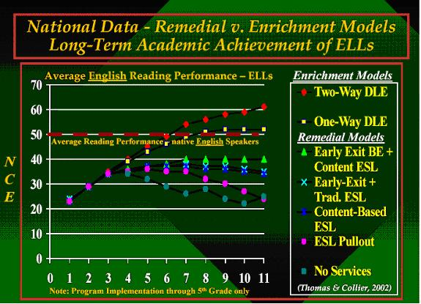
W. Thomas and V. Collier, 2002

Slide 27
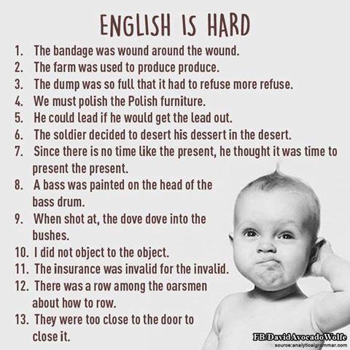

Slide 28
The Power of Cognates
La chimica è la scienza che studia la composizione della materia ed il suo comportamento in base a tale composizione.

Slide 29
The Power of Cognates
La chimica è la scienza che studia la composizione della materia ed il suo comportamento in base a tale composizione.

Slide 30
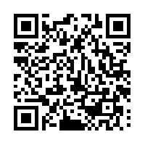
Your Turn!
1. Individually make a list of 5 academic words from any content area, except ELAR.
2. Turn to your partner and combine your two lists of words (even if from different content areas).
3. Write the Spanish translations next to each academic word. Use Google Translate if needed.
4. Calculate what percentage of the words are cognates.
1 – 2 – 4 – ALL
http://www.realfastspanish.com/vocabulary/spanish-cognates

Slide 31
Session Objectives
Content Objective
Language Objective
Today I analyzed the second language acquisition process and understood its impact in the education of English Language Learners.
Today I discussed with my peers the second language acquisition process and I shared orally and in writing my individual language profile.

Slide 32

Tickets Out
I used to think…
But now I know…

Slide 33
Mil gracias
See you 11/01!
Karina E. Chapa, M.Ed.
Language Proficiency, Biliteracy and Cultural Diversity Director
kchapa@esc1.net
Facebook: Region One ESC Bilingual
Twitter @esc1bilingual @bilingualpride

